Slide 1
PRODUCT LIFECYCLE MANAGEMENT
  Guided By – Deepali Joshi Ma'am
    18 - Abhijit Gawai
    29 - Shyam Kawale
    43 - Nishant Bhat
    50 - Bhargav Pawar
    55 - S. Abhishek

Slide 2
CONTENTS
Introduction
History
Benefits
Phases of PLM
Types of PLM
Product Lifecycle costing
How to estimate Lifecycle Cost
Purpose of PLM cost analysis
PLM integration with ALM
Engineer change request
Cross function team

Slide 3
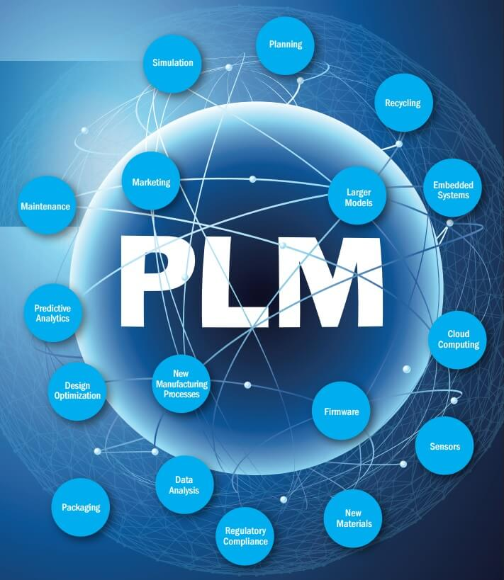
WHAT IS PLM EXACTLY?
Product lifecycle management, sometimes "product life cycle management", represents an all-encompassing vision for managing all data relating to the design, production, support and ultimate disposal of manufactured goods.
PLM concepts were first introduced where safety and control have been extremely important, notably the aerospace, medical device, military and nuclear industries.
Over the last ten years, manufacturers of instrumentation, industrial machinery, consumer electronics, packaged goods and other complex engineered products have discovered the benefits of PLM solutions and are adopting efficient PLM software in increasing numbers.

Slide 4
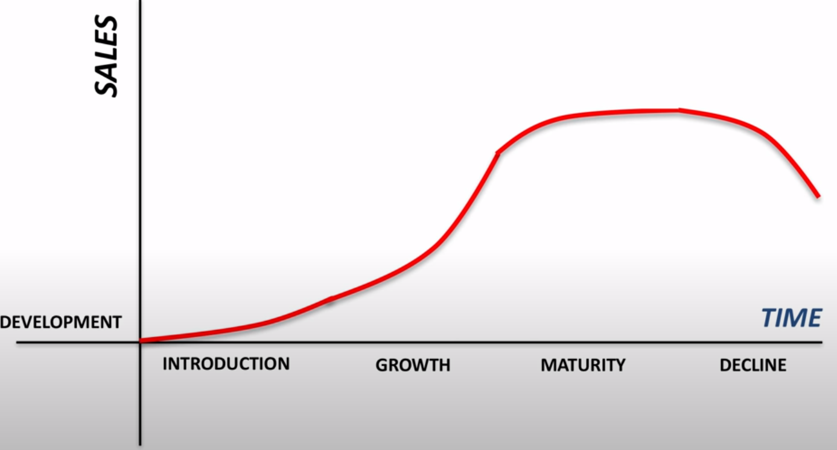
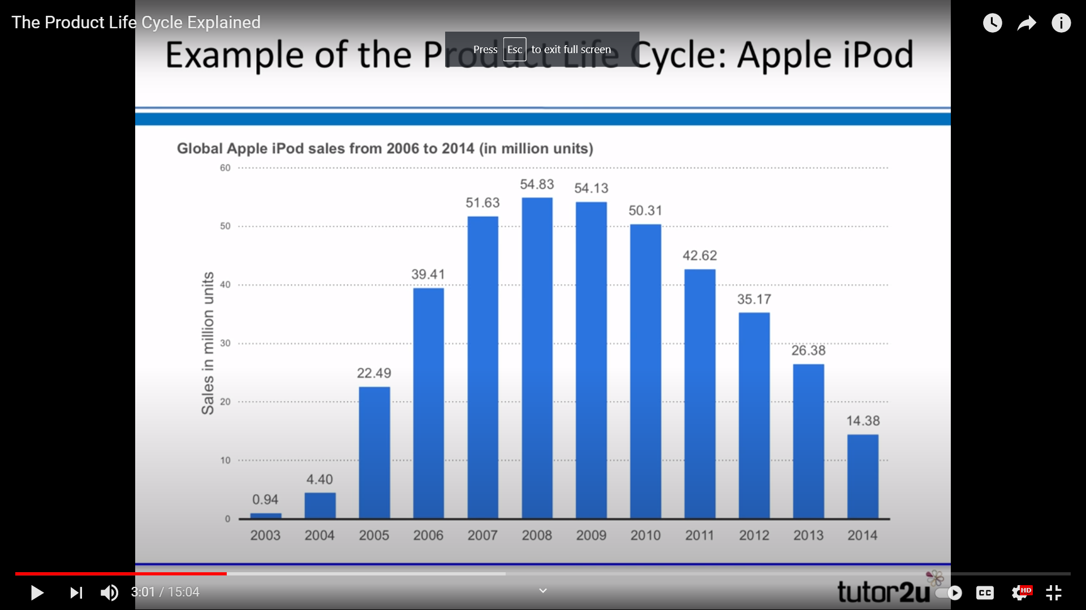
PRODUCT LIFECYCLE CHART

Slide 5
BENEFITS OF PLM
Reduce risk
Increased productivity
Cost management
Accelerated time to market
Increased revenue
Data sharing
Centralisation
Better quality product
Scaling your business

Slide 6
Phases of PLM
-
Product Concept
Service
Product Design
PHASES OF PLM
Production

Slide 7
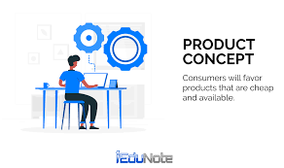
Product Concept
Imagine, Specify, Plan, Innovate.
More Research oriented Phase to understand both markets and people requirement.
Concept of product and Specifications helps to define technical parameters.
A good PLM system allows designer to easily track evolution of product

Slide 8
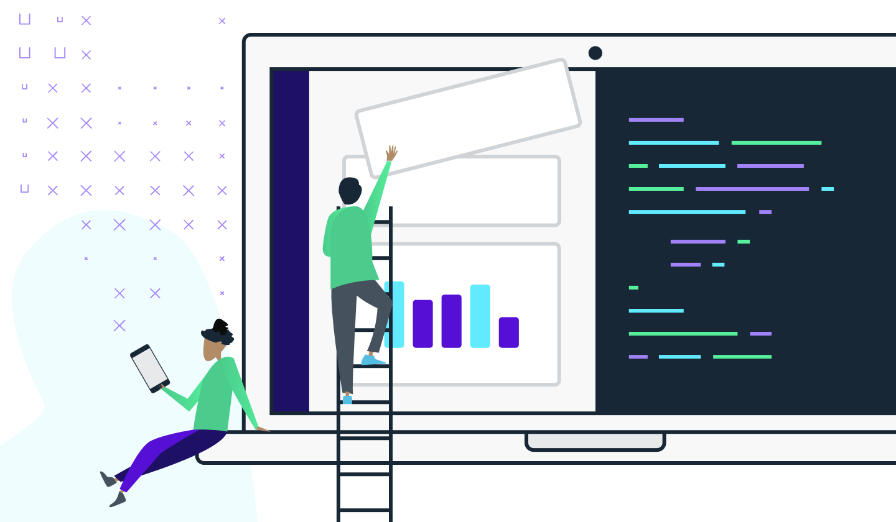
Product Design
Describe, Design, Develop, Test, Analyze, Validate.
Designer works to make concept of product into reality.
This phase comprises of creating mock-ups, prototypes and final testing.
Nowadays this solutions will include integration to 3rd party vendors to streamline the design process.
- ex: Adobe illustrator plugin

Slide 9
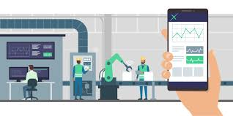
Production
Manufacture, Make, Build, Procure, Produce, Sell, and Deliver.
Manufacturing Phase of product lifecycle.
A business must account for a host of new components such as sourcing of material, costs, origin, productivity quotas, timelines and more.
A Business’s PLM system must account in this phase or else it will face unexpected costs, delays and inaccurate forecasts.

Slide 10
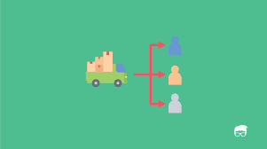
Service
Use, Operate, Maintain, Support, Sustain, Phase-out, Retire, Recycle and Disposal.
The last phase of the product lifecycle includes the proper distribution and maintenance of the final product.
This phase includes
  warehousing,
  distribution to various sales channels,
  understanding its performance using sales and customer support data.

Slide 11
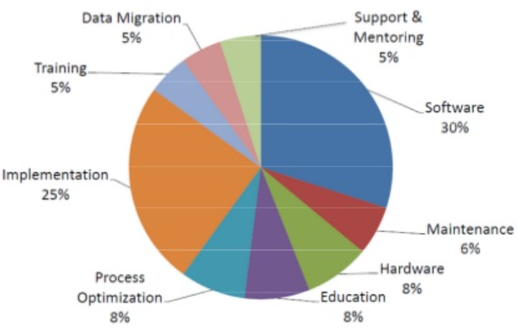
Product lifecycle costing
What is Product Lifecycle Management costing?
Why we need PLM cost?
PLM cost depends on many factors

Slide 12
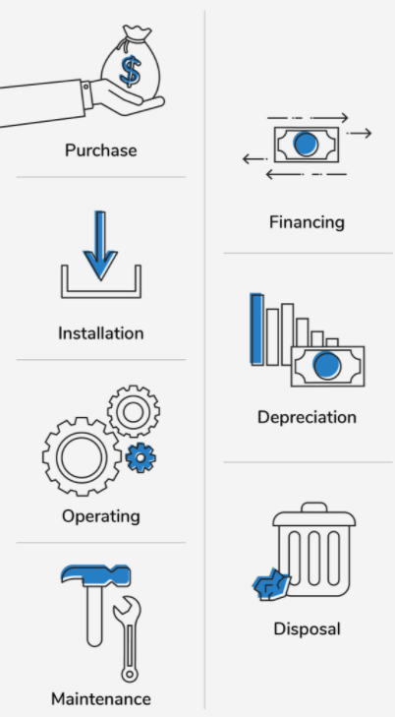
How to estimate Lifecycle Cost
Conducting a PLM cost helps to predict profit made by product
To calculate PLM cost, estimate following expenses
  Purchase
  Installation
  Operating
  Maintenance
  Financing (e.g., interest)
  Depreciation
  Disposal

Slide 13
Purpose of PLM cost analysis
Choose between two or more assets
Consider lower lifecycle price not initial price tag
Determine the asset’s benefits
Consider benefit in Long run
Create accurate budgets
PLM helps in building budget

Slide 14
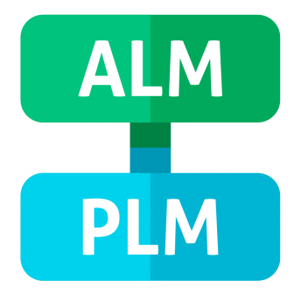
PLM AND ALM INTEGRATION
ALM (Application Lifecycle Management) is a different concept from PLM which deals with 3 aspects of a software lifecycle i.e. Governance, Development and Management. ALM has several SDLC that are used as a hybrid form.
PLM and ALM integrated for holistic development.
This integration is important for amazing end-user experiences. The best example for PLM and ALM integration is gaming console like Sony PlayStation

Slide 15
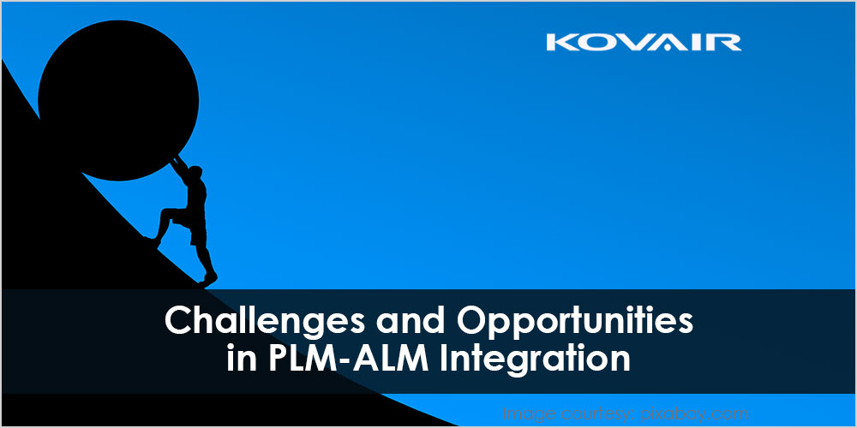
Challenges and opportunities in ALM and PLM integration
Challenges :
To get a true collaborative environment
Challenges to bring ALM into the framework of PLM
Experiences of engineers by the integration of ALM and PLM
Opportunities :
PLM-ALM integration can help the development teams to overcome the challenges of changing market requirements.
Clear, concise and timely communication

Slide 16
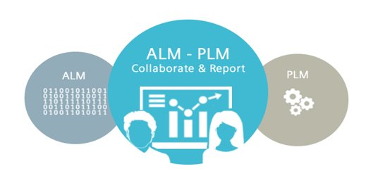
Levels of ALM-PLM integration.
Level 1: Link & Trace
Level 2: Change & Propagate
Level 3: Act & Communicate
Level 4: Align & Unify
Level 5: Collaborate & Report

Slide 17
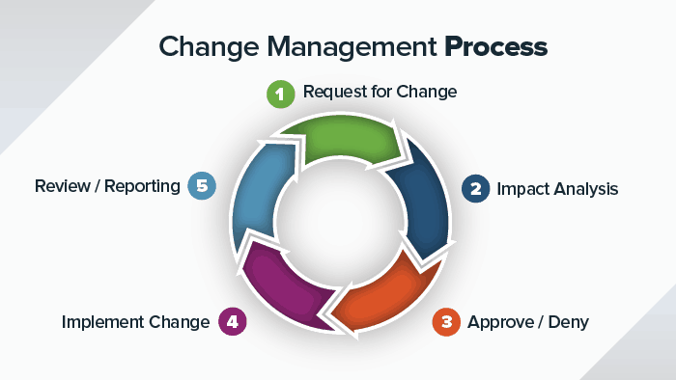
Engineer Change Request
Change management also know as configuration management is a vital part of Product Lifecycle Management.
An Engineering Change Request (ECR) allows anyone with a Full User account to request changes to existing objects.
Use an ECR only for revising existing objects not for the birth of new objects.

Slide 18
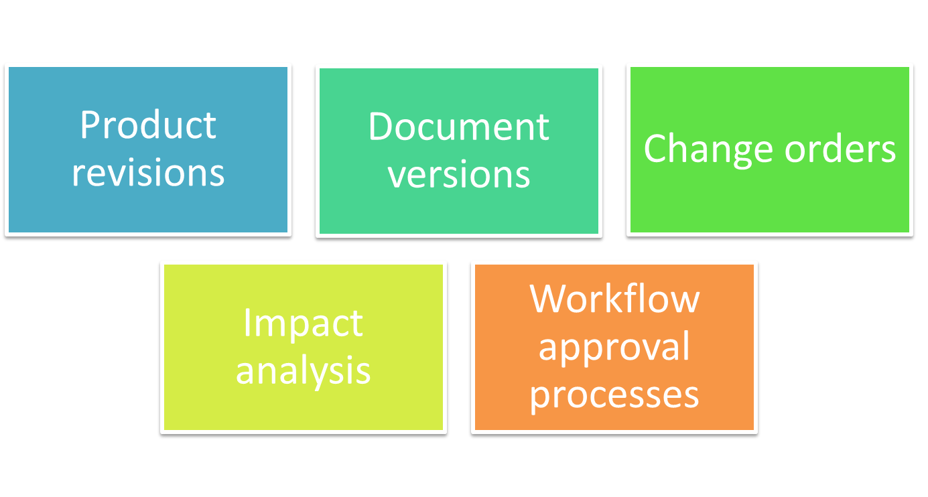
ECR Key Capabilities
Notes:
pa

Slide 19

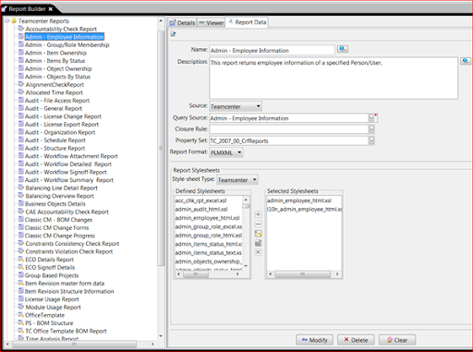
Cross Function Team
Cross Functional team is a group of people with different functional expertise working toward a common goal.
It includes employees from all levels of an organization. Members may also come from outside an organization, from suppliers, key customers, or consultants.
Members –
  Initiator
  Application Engineer
  Product Engineer
  Quality Engineer
  Purchase & Sales

Slide 20
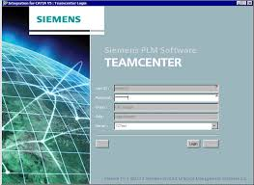
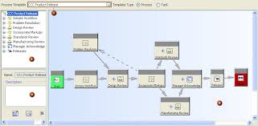
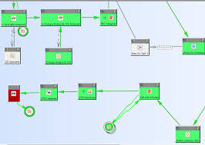
Teamcenter 10

Slide 21
REFERENCE
https://www.propelplm.com/articles/top-10-benefits-of-plm-software
https://www.propelplm.com/articles/what-is-product-lifecycle-management
https://www.patriotsoftware.com/blog/accounting/life-cycle-costing-process/
https://www.propelplm.com/articles/change-management-definition
https://www.plm.automation.siemens.com/global/en/products/software-engineering/plm-alm-integration.html
https://www.kovair.com/blog/challenges-opportunities-in-plm-alm-integration/#:~:text=Challenges%20of%20PLM%E2%80%93ALM%20integration,%2C%20and%20cross%2Ddomain%20communication

